Slide 1

Workshop on Developing Corporate Bond Market
22 September 2008 Shanghai, PRC
Session 1: Overview of Corporate Bond Market in Asia-Pacific Region
Mr. Masato Miyachi
Office of Regional Economic Integration
Asian Development Bank

Slide 2
Outline
Rationale to develop corporate bond markets
Basic factors for the development of corporate bond markets
Private-Public sector cooperation to promote corporate bond markets

Slide 3
Advantages of corporate bond finance
Corporate bond markets can:
Reduce the double mismatch problem (currency and maturity)
Reduce over-dependence on bank borrowing and lower borrowing costs
Contribute to efficient resource allocation
Mitigate risks
Provide an alternative source of funds

Slide 4
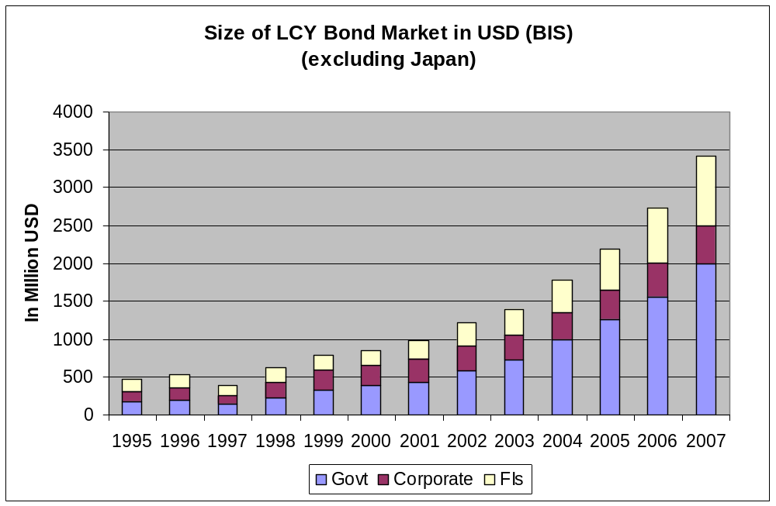

Slide 5
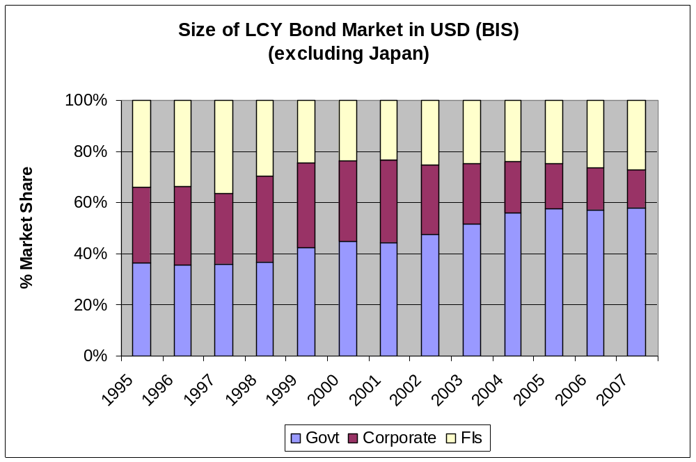

Slide 6
Corporate bond market development
Corporate bonds in ASEAN+3 countries grew 25.6% from 2006-2007.
However, corporate debt markets continue to be underdeveloped and shrinking
  Less than one-third of the over 100 countries with equity markets have corporate debt markets
  Corporate debt markets average only one-tenth the size of the corresponding equity markets

Slide 7
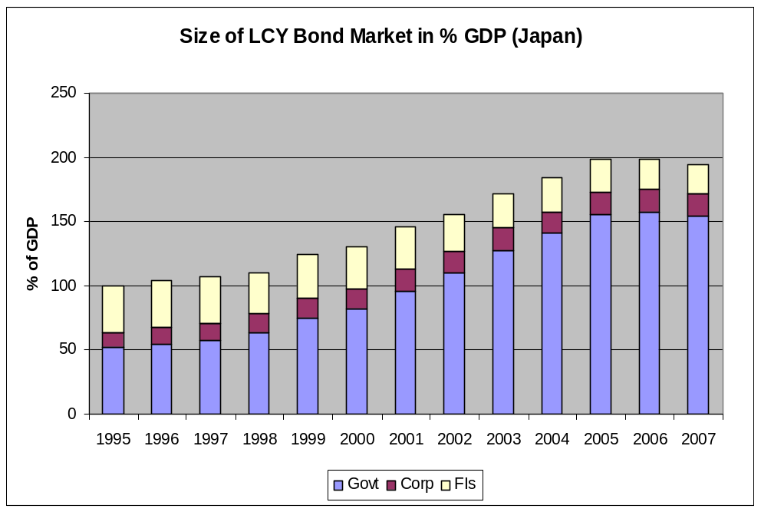
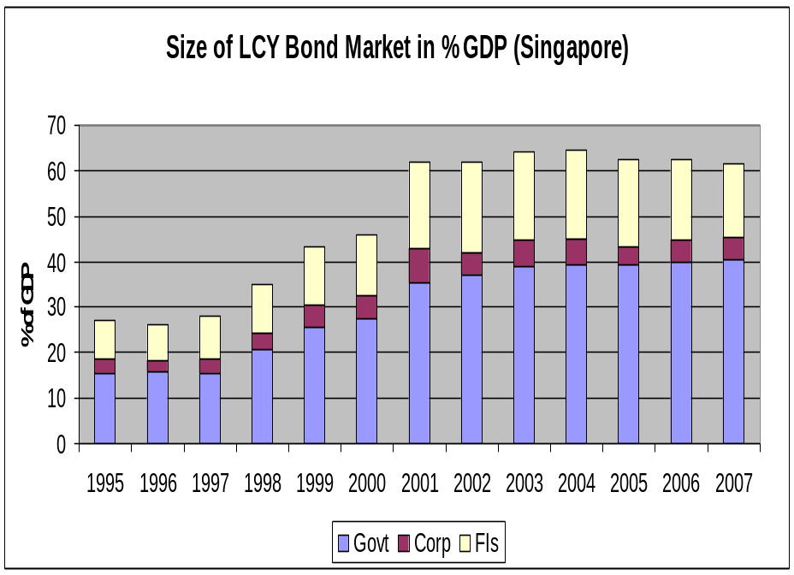
Bond Development Indicator*
* AsianBondsOnline

Slide 8
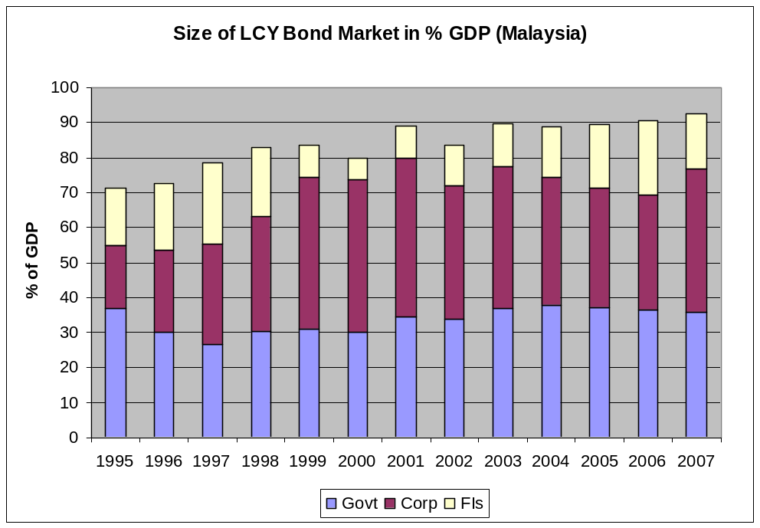
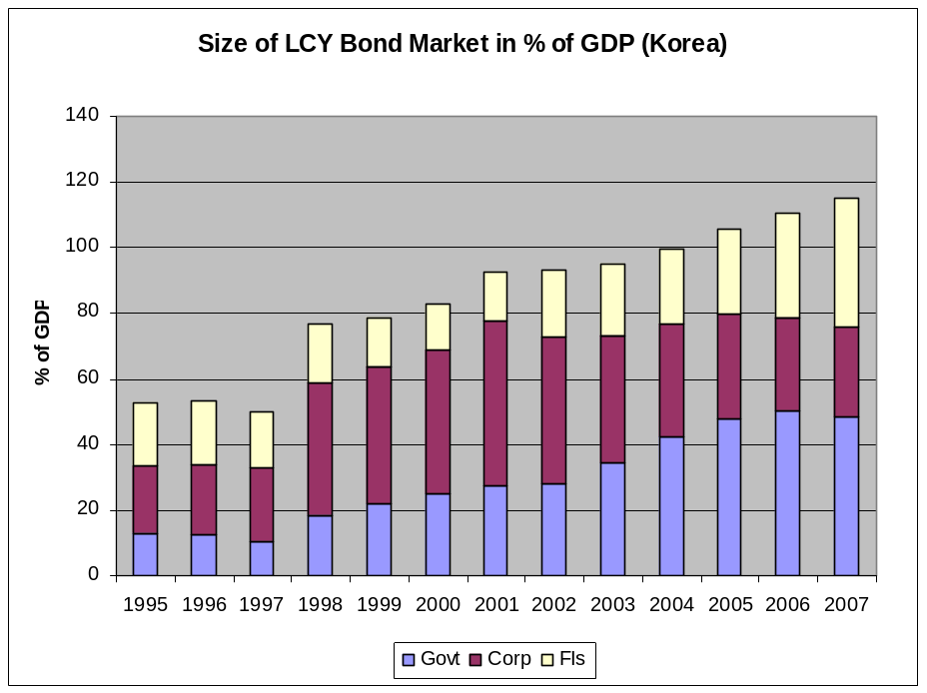
Bond Development Indicator

Slide 9
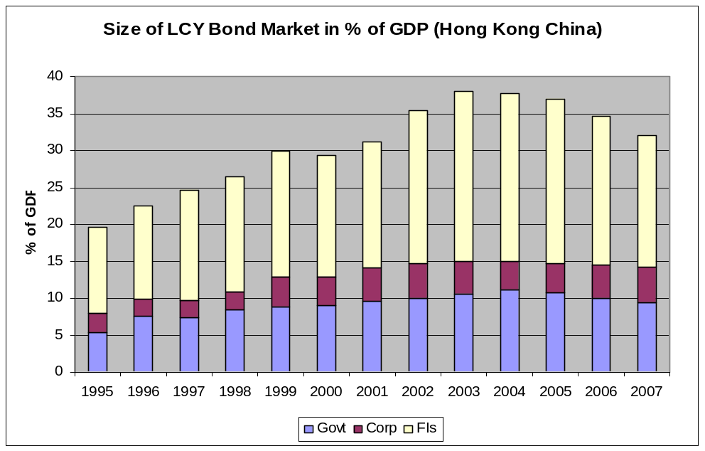
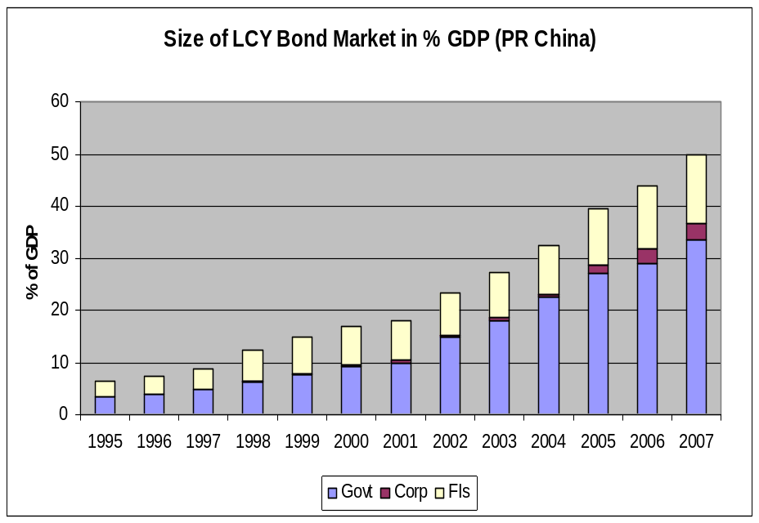
Bond Development Indicator

Slide 10
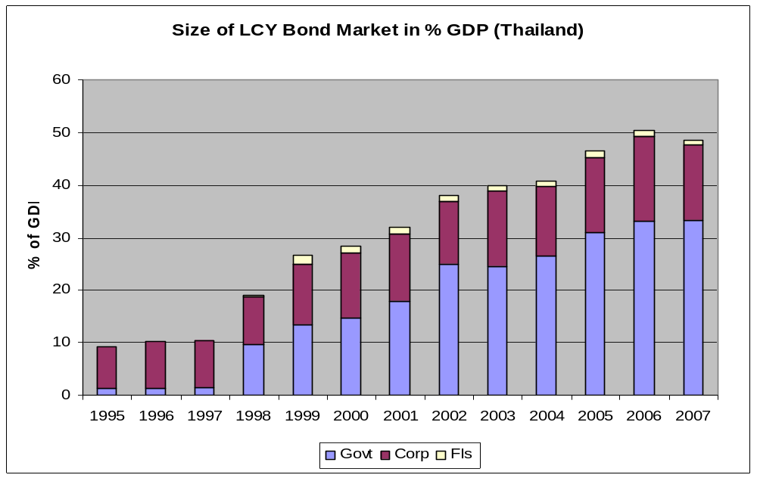
Bond Development Indicator

Slide 11
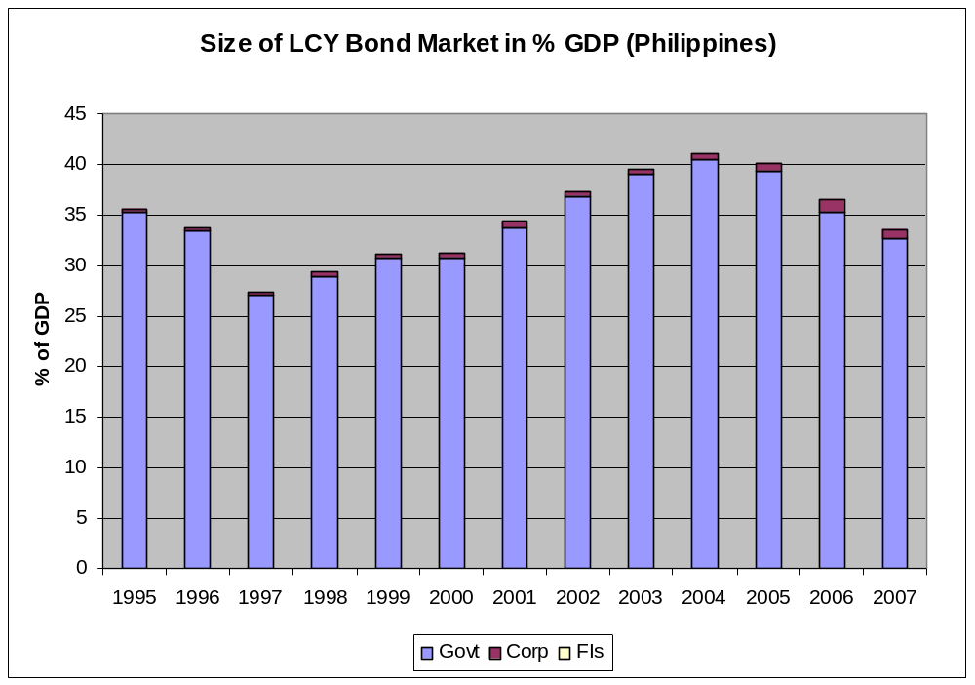
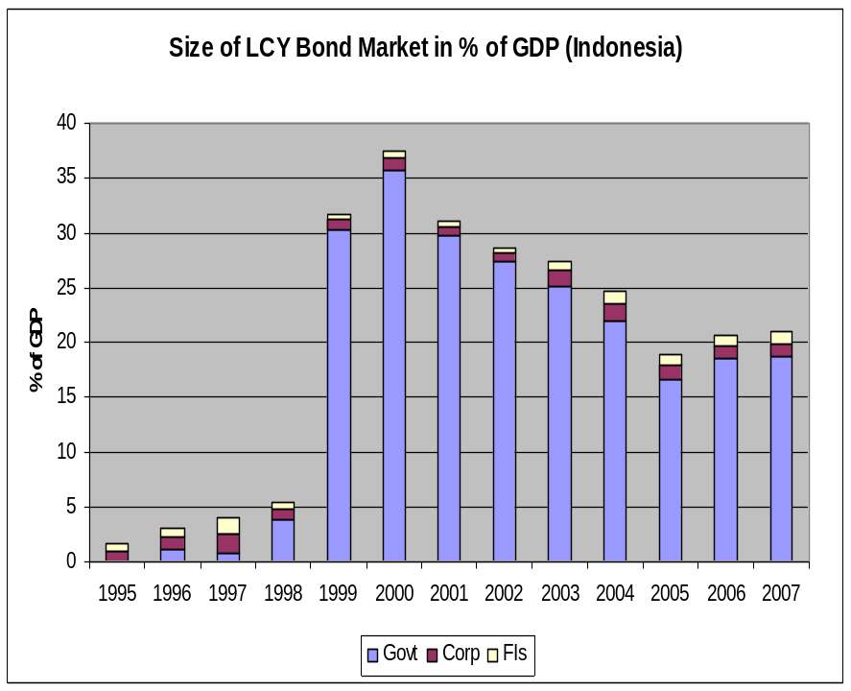
Bond Development Indicator

Slide 12
Critical Areas or Factors of Bond Development*
Bond markets are basically influenced by:
Government Policies
Regulatory Framework
Market Infrastructure
Liquidity
Risk Management
* Compendium of Sound Practices, ADB

Slide 13
Government Policies Factor
The government:
is a key player as an ISSUER, REGULATOR, FACILITATOR, PROMOTER and CATALYST in the initial stage of bond market development (ex. Malaysia and Korea)
strikes balance between Sovereign Debt Management Policy and Bond Development Strategy
can provide consistent tax policies for all financial instruments and participants

Slide 14
Government Policies Factor
Malaysia
promoted development of needed infrastructure for bond market development including bond rating agencies, and made bond ratings mandatory
actively encouraged Employee Provident fund to invest in corporate bonds to help finance infrastructure and energy investments
by 2000 corporate debt market in Malaysia amounted to 47% of GDP from just 4% in 1989

Slide 15
Government Policies Factor
  Korea
  Korean government first approved the Capital Market Promotion Act of 1968.
  In the 70's, the government introduced guaranteed corporate bonds and ensured that corporate bonds issued by the industrial conglomerates (chaebols) carried bank guarantees.
  By 2000, corporate debt market rose to 26% of GDP from 11.1% in 1989.

Slide 16
Government Policies Factor
Government support for the development of the corporate bond markets in Malaysia and Korea were substantial and sustained.
Relatively rapid development of bond markets in Malaysia and Korea suggest that government support is important for bond market development at least in the initial stage.
However, government interventions should be carefully designed to avoid problems.

Slide 17
Regulatory Framework Factor
Adequate investor protection and sound business practices or codes of conduct that reduce systemic risks to the minimum
Clearly defined market rules, a high degree of transparency as well as high prudential standards and governance principles that recognize the importance of fiduciary obligations

Slide 18
Market Structure Factor
Governed by clear and unambiguous rules and procedures that are soundly enforced and made freely available to interested parties
Participants form clear expectations about the operation of the systems in times of stress and the financial risks involved

Slide 19
Liquidity Factor
Accurate and reliable benchmark yield curves
Certainty about reliable pricing for bonds
Availability of information on market conditions, and issuer decisions and actions
Minimized transaction cost
Diverse participants (including pension, insurance and mutual funds)

Slide 20
Risk Management Factor
Made effective by both Issuer (especially government) and Investor
Risk Audit conducted accurately
Risk management frameworks
Market intermediaries to transfer risk
Clear delineation between risk-taking, risk-monitoring & internal control systems
Credit Rating agencies’ credibility and reliability

Slide 21
Other factors
Timeframe required to implement necessary reforms to fully develop corporate debt markets cannot be easily determined
Sense of urgency has to be promulgated and professed
Strong political will and efficient coordination and cooperation among authorities
Central Banks

Slide 22
Public-Private Sector Cooperation in Developing Corporate Bond Market
Financial sector stability is the key word
  Constructive partnership between government, banks, and corporate sector in creating diversified and competitive financial sector
Sustained government support in development of corporate bond market
  Creating benchmark yield curve
  Strengthening institutional investors
  Adopting outward looking policies

Slide 23
Public-Private Sector Cooperation in Developing Corporate Bond Market
Firms need to adopt to rapid changes in the international market to remain competitive.
  Make data on bond prices and quantities available on real-time.
  Develop professional information services.

Slide 24
Public-Private Sector Cooperation in Developing Corporate Bond Market
Fostering complementary relationship between banks and corporate bond market
    Promote supportive role of banks in corporate bond market development.
    Continue to strengthen banking system at the same time initiate development of corporate bond market by removing barriers.

Slide 25
Thank you.
For More Information:
Mr. Masato Miyachi
Senior Advisor
Office of Regional Economic Integration (OREI)
mmiyachi@adb.org
(+63-2) 632-6832

